Slide 1
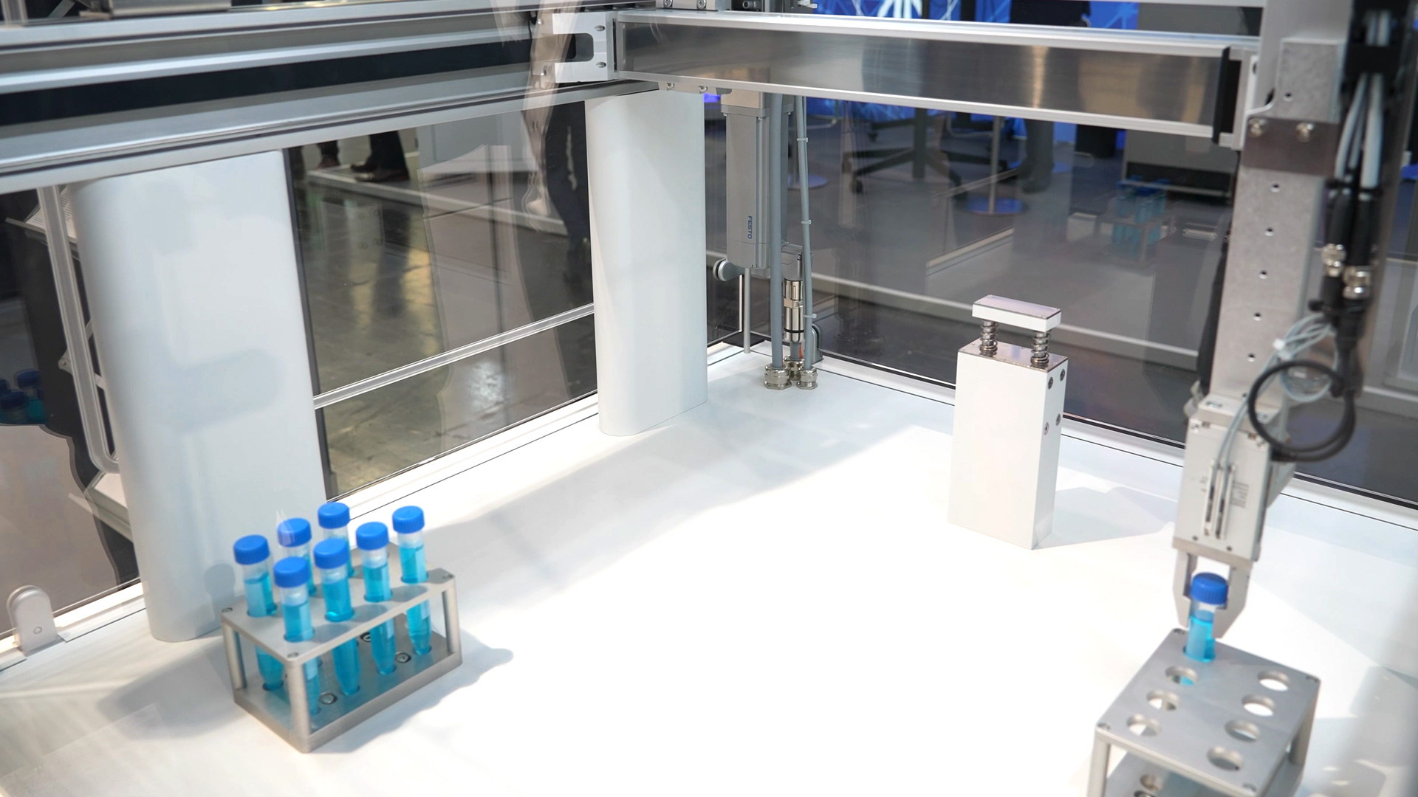
INDIA-FIRST BUSINESS MODELS
FOR ADAPTIVE GANTRY & VLA
Lab Automation in Diagnostic Labs
A STRATEGIC FRAMEWORK FOR WORKFLOW INFRASTRUCTURE MONETIZATION
June 2026

Slide 2
EXECUTIVE OVERVIEW
Table of Contents
01
Executive Summary & Strategic Vision
04
Business Model Architecture
02
Problem Definition & Solution Architecture
05
Go-to-Market Strategy
03
Market Validation & Evidence
06
Rejected Models & Rationale
07
Risks, Limitations & Conclusion
PRESENTATION AT A GLANCE
33
6
3
4
Slides
Models Analyzed
Revenue Pillars
Phases of Evolution

Slide 3
01
EXECUTIVE SUMMARY & STRATEGIC VISION
The highest-probability commercial model and the strategic reasoning behind it

Slide 4
Hybrid Model: Upfront + Recurring Software + Service Revenue
THE RECOMMENDED MODEL
PHASE-ONE WEDGE
1. Upfront Deployment Fee for hardware and integration
2. Recurring Software & Support revenue locked in
3. Smaller Recurring Revenue from workflow packs, PM kits, SLA tiers
This structure matches the underlying problem: Indian labs have real pain in manual "glue work," sample movement, routing, and repetitive handoffs.
Gantry-based tube handling in constrained lab spaces
Fixed gantries carry lower safety and integration burden than general-purpose arms
Modular automation cell for: tube pickup, barcode reading, sorting, buffer handling, rack transfer, analyzer handoff, traceability-heavy "glue work"
Key Strategic Insight: The buyer is not purchasing a fascinating robot. The buyer is purchasing fewer failure points, tighter TAT, lower manual handling, and a cleaner quality narrative during accreditation or audit. Recurring software and service must be part of the core offer, not an optional add-on.
Why this model wins: CapEx creates lumpy revenue and weak recurring economics. Pure RaaS pushes asset-financing and utilization risk back onto the startup. Transactional per-test pricing under-monetizes value without minimum guarantees. Licensing is attractive later but not for day-one monetization.
04

Slide 5
Three Critical Insights That Shape Our Strategy
MEASURE SUCCESS QUANTIFIABLY
QUALITY NARRATIVE OVER NOVELTY
SOFTWARE IS THE MOAT
The biggest challenge is measuring our success with hard numbers. Every claim must be backed by data: TAT reduction, error rates, uptime percentages, manual touch reduction.
Don't sell the robot by marketing its technology as novelty. Sell using the narrative: "Our robots keep all the other robots in your lab busy."
Selling software as part of the package lets us track performance and gather data. This enables calculating TAT, IQ, OQ - metrics that help push our robot and create lock-in.
FRAMEWORKS, NOT POINT SOLUTIONS
We are building frameworks that must theoretically automate every general-purpose task. Test tube handling is just the demonstration. The bet is on VLA-based systems growing to enable full automation.
05

Slide 6
02
PROBLEM DEFINITION & SOLUTION
What we are solving, why gantry-first, and the phased evolution path

Slide 7
The Problem: Manual "Glue Work" Killing Lab Efficiency
THE PAIN POINTS
OUR APPROACH
Manual "glue work" - Sample movement, routing, repetitive handoffs
We are building frameworks that must theoretically automate every general-purpose task in a diagnostic lab.
Test tube handling is just the demonstration of our capabilities - the wedge to enter the market.
The bet is on VLA-based systems (Vision-Language-Action) growing good enough to make full general-purpose automation possible.
Fragmented departments - No seamless workflow between departments
High-cost consultant-driven automation - Expensive external consultants
Underutilized staff - Skilled techs doing repetitive manual tasks
Assistive Robot Capability: The controller used to train the robot can directly be used as an assistive robot for heavy work. As training software improves, assistive mechanics improve too. Assistive tasks can be recorded to train the VLA.
"We don't focus on a specific process that needs automation. We focus on building a general policy that can automate every general-purpose task."
07

Slide 8
The Wedge: Four-Phase Evolution from Simulation to Full Automation
PHASE 0
PHASE 1
PHASE 2
PHASE 3
Simulations & Grants
Simple Gantry
Gantry + Arm
Gantry + 2 Robotic Arms
Prototype everything on Coppeliasim
Train VLA using simulator
Acquire grants (EITB Shakti, Thiel Foundation, Merantix)
Simulator VLA framework can be sold as software or open-sourced
Tube pickup
Barcode scanning
Tube routing
Rack placement
Also works as assistive robot for heavy loads
Fridge handling
Centrifuge loading/unloading
Analyzer loading
Assistive capability continues
General-purpose robotic arms
Multi-lab workflows
Full adaptive automation
Each phase extends financial runway AND deployed robots feed data that makes the model better
Why this wedge works: Each phase doesn't just extend the financial runway - the deployed robots feed data that makes the VLA model better, which unlocks more possibilities and resources to tackle the next phase. The same controller and PID software enable both autonomous and assistive modes.
08

Slide 9
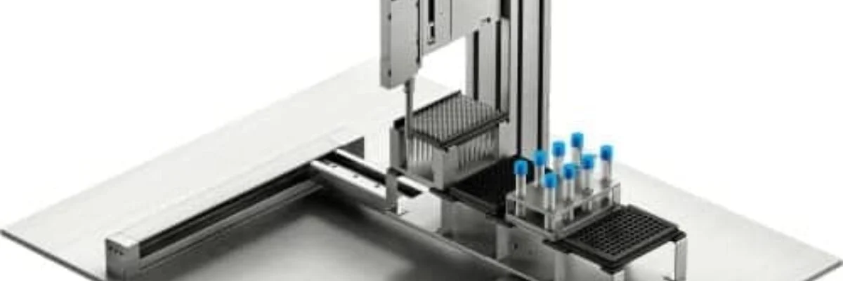
Why Gantry First: Lower Safety Burden, Faster Deployment
ROBOTIC ARM
GANTRY ROBOT
PROS
PROS
Flexible - can reach many places
Can handle complex multi-axis movements
✓ Simpler - fewer moving parts
✓ Cheaper - lower BOM cost
✓ Safer - fixed overhead structure
✓ Easier to install and maintain
✓ More precise for moving tubes
CONS
✕ Expensive - high capital cost
✕ Complex - more points of failure
✕ Safety concerns - moving arm in lab space
✕ Harder to integrate with existing benches
✕ More maintenance required
CONS
✕ Less flexible - confined to rail path
80% of the lab automation problem is simply: "Move this tube from Point A to Point B." A gantry does this very well. Instead of building a humanoid robot on day one, we start with a gantry system and add intelligence through the VLA.
Fixed gantries fit constrained spaces and impose lower safety burden than mobile arms. They are the optimal wedge for Indian diagnostic labs with limited floor space and high sample volumes.
09

Slide 10
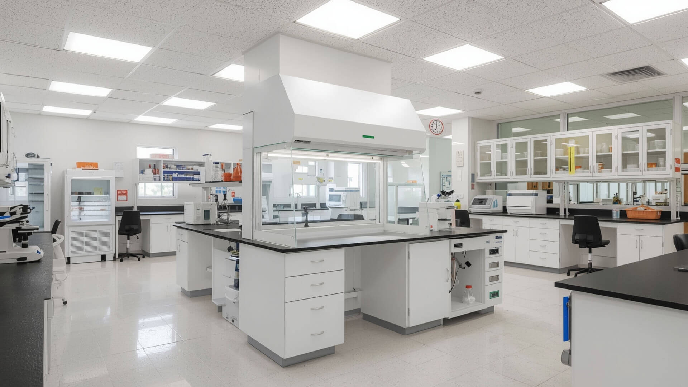
03
MARKET VALIDATION
Market signal, buyer behavior, and competitive dynamics in Indian diagnostics

Slide 11
Indian Diagnostics Market: National Scale, Real Growth, Proven Demand
85.6M
290+
8.5-10%
12,000+
Samples collected by Dr Lal PathLabs annually
Labs operated by Dr Lal PathLabs + 6,600+ patient service centres
Sample-volume growth across recent periods (Reuters)
Patient touchpoints by Metropolis Healthcare
DR LAL PATHLABS
METROPOLIS HEALTHCARE
Scale: 85.6M samples, 290+ labs, 6,600+ patient service centres
Growth: 8.5-10% sample-volume growth (Reuters reports)
Quality focus: Real-time QC monitoring, quality checks on every sample, daily quality indicators
Digital: Emphasizes report access, tracking, operational convenience
Scale: 170+ advanced labs, 12,000+ patient touchpoints
Menu: 4,000+ tests and profiles, 2,000+ scientific officers
Growth: Continuing growth in specialty and preventive testing
Quality focus: Sample tracking, calibration, internal and external quality checks
Competitive Pressure: Amazon's entry into home diagnostics signaled that digital platforms can pressure incumbents on convenience. Both Dr Lal and Metropolis emphasize report access, tracking, and operational convenience.
Sources: Dr Lal PathLabs Public Site; Metropolis India; Economic Times - Amazon Home Testing; Reuters India Coverage
11

Slide 12
Automation Budgets Exist - But Incumbents Are Too Expensive
4,000+
2,000+
> Rs.3 Cr
Tests per hour at SGPGIMS fully automated pathology laboratory
Tests per hour at AIIMS Bhopal cobas pro system
Reagent-rental arrangement value at AIIMS Bhopal
EXISTING AUTOMATION BENCHMARKS
Institution | System | Throughput | Financial Structure
SGPGIMS | Fully automated pathology lab | 4,000+ tests/hour | Full CapEx deployment
AIIMS Bhopal | cobas pro system | 2,000+ tests/hour | Reagent-rental > Rs.3 crore
Karnataka (PM-ABHIM) | District integrated public health lab | Public health scale | Established at ~Rs.1.1 crore
THE STRATEGIC TAKEAWAY
Buyers already understand automation value, but incumbent price points are often too high, too centralized, and too rigid. A modular Indian product priced well below these benchmarks can be positioned as a budget-responsible alternative for a narrower, high-friction workflow wedge.
Sources: Times of India - SGPGIMS; Times of India - AIIMS Bhopal
12

Slide 13
Target Customer: NABL-Accredited Labs, 800-5,000 Samples/Day
IDEAL CUSTOMER PROFILE
WHY NABL ACCREDITATION MATTERS
▶ NABL-accredited or accreditation-seeking
▶ Processing 800 to 5,000 samples/day
▶ Has LIS connectivity
▶ Multiple analyzer benches
▶ Meaningful TAT pressure
▶ Quality team caring about tracking, calibration, auditability
NABL's medical-lab accreditation framework is anchored to ISO 15189, which reinforces why auditability, validation, and traceable process changes matter commercially.
Labs with accreditation pressure are more willing to invest in automation that provides documented quality improvements.
TAT PRESSURE = BUYING SIGNAL
TAT (Turnaround Time) is the perfect metric for our pilots - easily measurable and labs care about it deeply.
Faster reports = happier doctors, happier patients, more samples processed, better business.
Example: Current TAT = 6 hours | Goal = 3 hours | Management asking "How can we process faster?"
Customer Selection Framework: This profile helps identify contracts and deliver conversion rates. Labs with LIS connectivity can record sample data, helping us calculate TAT before/after installation.
13

Slide 14
04
BUSINESS MODEL ARCHITECTURE
The hybrid revenue model, unit economics, and comparative analysis of all options

Slide 15
The Hybrid Model: Three Revenue Pillars
1
2
3
ONE-TIME DEPLOYMENT
SOFTWARE SUBSCRIPTION
SERVICE & SUPPORT
Rs.15-30 Lakh
Rs.50K-2L/month
Annual Tiers
▶ Gantry hardware
▶ Cameras & vision system
▶ Installation & integration
▶ LIS connectivity setup
▶ Initial training
This is your initial revenue
▶ VLA model updates
▶ Workflow improvements
▶ Analytics dashboards
▶ Monitoring & alerts
▶ Remote support
Predictable recurring revenue
▶ Basic: Business-hours support
▶ Premium: 24/7 support
▶ Enterprise: Dedicated engineer + fast response
▶ PM kits & wear parts
▶ Workflow packs
Why the hybrid model wins: Hardware alone does not compound fast enough. A hybrid model creates three assets simultaneously: deployment revenue, recurring software and support, and field data that later justifies workflow libraries, exception-prediction features, and licensing conversations. Opentrons and Automata both show how modern automation companies accumulate value above the hardware layer.
15

Slide 16
Unit Economics: Direct Cost Stack Per Deployed Cell
EXPLICIT AUTHOR MODEL - ANCHORED TO PUBLIC COMPARABLES, NOT VENDOR QUOTES
Cost Component | Indicative Range (INR)
Industrial BOM (motion, structure, vision, controls, safety) | Rs.9 lakh - Rs.13 lakh
Assembly, calibration, factory testing | Rs.1.5 lakh - Rs.2.5 lakh
Installation, FAT/SAT, IQ/OQ validation, training | Rs.1.5 lakh - Rs.3 lakh
First-year spare and field-service reserve | Rs.1 lakh - Rs.2.5 lakh
TOTAL DIRECT COST | Rs.12 lakh - Rs.18 lakh
ECONOMIC VALUE MODEL
The main economic win is NOT reagent margin but a combination of:
▶ Fewer manual touches
▶ Lower error/rerun burden
▶ Throughput elasticity
▶ Better bench utilization
Unlike analyzer vendors, we don't control test chemistry or assay menus.
Ongoing software, cloud, monitoring, support: Rs.0.1-0.4 lakh/month (depends on edge vs cloud inference split)
DEPLOYMENT OPTIONS
EDGE
CLOUD
AI runs locally (NVIDIA GPU). Faster, more private, no internet dependency.
AI on remote servers. Cheaper hardware. Cloud bills. Internet dependency.
Important: We do NOT make income by selling reagents like other companies. Analyzer vendors use a "printer and ink" model. We only automate processes in between - focusing on a completely untouched market.
Public anchors: Opentrons list pricing, Automata cloud/support posture, Indian hospital automation benchmarks, current INR conversion at Rs.95.785/USD
16

Slide 17
Full Model Comparison: Six Business Models Analyzed
Model | Revenue Streams | Pricing (INR) | Blended GM | Buyer Payback | Assessment
CapEx Hardware Sale | Hardware, installation, AMC, software license, workflow packs | Rs.30-55L per cell; AMC 10-15%; Software Rs.6-12L/yr | 45-58% | 18-30 months | Viable, not ideal as only model
RaaS / Opex | Monthly subscription: hardware use, support, software, monitoring, upgrades, SLA | Rs.3-8L/month + Rs.2.5-6.5L over 36-60 months | 55-70% | 3-9 months | Excellent for lighthouse, too capital-heavy as default
Hybrid (RECOMMENDED) | Upfront hardware + recurring software, support, PM kits, consumables, workflow libraries | Rs.18-30L entry + Rs.0.75-2L/month; PM Rs.1-4L/yr | 55-68% | 9-18 months | Best default model for India-first
Transactional Per-Test | Fee per test/sample automated, often bundled with minimum monthly floor | Rs.1.5-5 per test; Rs.3-12 per automated handoff | 35-60% | 0-6 months | Useful with floor or as pilot overlay, not standalone
Revenue-Share | Share of incremental revenue or labor savings; 3-8% of baseline | Rs.1.5-3L/month floor + 15-30% of audited savings | 30-55% | Immediate if floor modest | For bespoke strategic pilots, not core model
Licensing & IP | OEM license, orchestration software, workflow IP, NRE, white-label | NRE Rs.20-75L; Annual license Rs.50L-Rs.2Cr+ | 75-90% | Partner-specific | Attractive second-act, not initial wedge
Indicative model, not price quotes. Public anchors: Opentrons, Automata, SGPGIMS, AIIMS Bhopal, Metropolis, INR conversion at Rs.95.785/USD (June 4, 2026)
17

Slide 18
CapEx Hardware Sale: Viable But Lumpy Revenue
PRICING MECHANICS
CASH FLOW & TIMING
Production cell: Rs.30-55 lakh per unit
Installation & validation: Rs.2-6 lakh
Annual AMC: 10-15% of hardware value
Software license: Rs.6-12 lakh/year
Direct cost: Rs.12-18 lakh per cell
Blended GM: 45-58% if pricing discipline holds
Payment milestones: Around PO, FAT, SAT, and acceptance
Working capital need: Moderate - mainly for inventory and receivables
Buyer payback: Typically 18-30 months unless throughput gains are strong
Normalized year-one ARPU: Rs.33-61 lakh
WHERE IT FITS & RISKS
✓ Fits private labs that already buy analyzers and benches
✓ Best near-term cash if payment milestones structured
✓ 2,000+ samples/day lab can justify the spend
✕ Long enterprise procurement cycles
✕ Price pressure, tender-driven
✕ Lumpy revenue, weak recurring base
✕ Expansion depends on new hardware sales
Verdict: Viable, but not ideal as the only model. Strongest where the lab has robust equipment-buying process. Weakest where the startup needs recurring revenue and predictable fleet economics.
18

Slide 19
RaaS/Opex Subscription: Excellent for Lighthouse, Too Capital-Heavy as Default
PRICING MECHANICS
STARTUP IMPACT
Monthly fee: Rs.3-8 lakh
Plus: Rs.2.5-6.5 lakh over 36-60 months
Covers: Hardware use, support, software, monitoring, upgrades, optional minimum-uptime SLA
Steady-state GM: 55-70% if utilization high and service load controlled
Buyer payback: 3-9 months (low upfront)
▶ Hardest on startup balance sheet
▶ Requires financing line, asset SPV, or investor tolerance
▶ CAC: Rs.5-9 lakh
▶ CAC payback: 8-14 months
▶ 5-year LTV: Rs.35-90 lakh
▶ Annual churn: 8-15%
WHERE IT FITS & RISKS
✓ Very attractive for private buyers wanting Opex approval
✓ Easiest to explain to procurement
✓ Best balance of margin and retention at scale
✕ Underpriced contracts risk
✕ Uptime liabilities on startup
✕ Hardware damage risk
✕ Poor asset recovery if customer defaults
Verdict: Excellent for lighthouse accounts, too capital-heavy as default. Works best when the lab is strategically valuable enough to justify financing and uptime risk. Selective RaaS for 1-3 lighthouse deployments only.
19

Slide 20
Transactional & Revenue-Share: Structurally Weak for Phase-One
PER-TEST PRICING
REVENUE-SHARE
Pricing: Rs.1.5-5 per test or Rs.3-12 per automated handoff
GM: 35-60% (heavily utilization-sensitive)
Buyer payback: 0-6 months (immediate because spend is variable)
✕ Startup doesn't control reagents/assays
✕ Value provided is up to lab's view
✕ Very hard to demand fair price
✕ Under-monetizes value without minimum guarantees
Pricing: Rs.1.5-3L/month floor + 15-30% of audited savings
GM: 30-55%
Buyer payback: Immediate if floor is modest
✕ Hard to prove causality
✕ Endless arguments about revenue source
✕ Labs: "The extra revenue wasn't because of your robot"
✕ For pre/post-analytical: usually messy
WHY THESE MODELS FAIL FOR US
Metropolis' public test catalog shows many routine tests in the low-hundreds to low-thousands of rupees range. An automation vendor's fee must stay a small share. Analyzer-style reagent-rental models work because the vendor owns recurring chemistry revenue. A pre/post-analytical startup generally does not.
Verdict: Both models are structurally weaker for phase-one diagnostics automation than in categories like assay reagents or payments infrastructure. Useful only with a floor that covers gross profit and financing cost, or as a pilot overlay - not as a standalone core model.
20

Slide 21
Licensing & IP: Attractive Second-Act, Not Day-One Wedge
REVENUE STRUCTURE
REQUIREMENTS FOR SUCCESS
NRE per integration: Rs.20-75 lakh
Annual license: Rs.50 lakh - Rs.2 crore+
Direct GM: 75-90% once platform is mature
Revenue streams:
▶ OEM license & orchestration software
▶ Driver/workflow IP licensing
▶ White-label integrations
▶ Developer tool access
Strong fit ONLY after company has:
▶ Credible fleet data
▶ Stable drivers
▶ Proven partner integrations
▶ Protectable IP
This only comes after Phase 3, where the VLA/V-JEPA model gets good enough to be useful for medical labs even without the robot.
RISK VECTORS
✕ Concentration risk - few large deals
✕ Long BD cycles (18-36 months)
✕ Dependency on partner roadmap
✕ IP leakage risk
Verdict: Attractive second-act model after field validation, not the initial wedge. Opentrons' OEM positioning shows platforms can expand into partner-driven revenue, but deals are strongest with credible deployments and custom drivers.
21

Slide 22
KPI Summary: Normalized to 2,000 Samples/Day, 26 Days/Month
For lumpy models (CapEx, Hybrid), "ARPU" = recognized revenue in year one, not recurring ARR alone
Model | Year-One ARPU | CAC | CAC Payback | Buyer Payback | 5-Yr LTV | Churn | Steady GM
CapEx | Rs.33-61L | Rs.6-12L | 1-4 mo | 18-30 mo | Rs.18-35L | <5% | 45-58%
RaaS | Rs.30-78L/yr | Rs.5-9L | 8-14 mo | 3-9 mo | Rs.35-90L | 8-15% | 55-70%
Hybrid | Rs.28-52L yr1 | Rs.5-10L | 6-12 mo | 9-18 mo | Rs.30-65L | 5-10% | 55-68%
Per-Test | Rs.2-4/test | Rs.4-8L | 12-24 mo | 0-6 mo | Rs.20-45L | 7-15% | 35-60%
Rev-Share | Rs.15-30L | Rs.6-10L | 12-24 mo | Immediate | Rs.18-50L | 10-20% | 30-55%
Licensing | Rs.50L-2Cr+ | Rs.10-25L | 18-36 mo | Partner-specific | Rs.75L-3Cr+ | Deal risk | 75-90%
Modeled assumptions by the author, using public anchors: Opentrons, Automata, SGPGIMS, AIIMS Bhopal, Metropolis, INR at Rs.95.785/USD
22

Slide 23
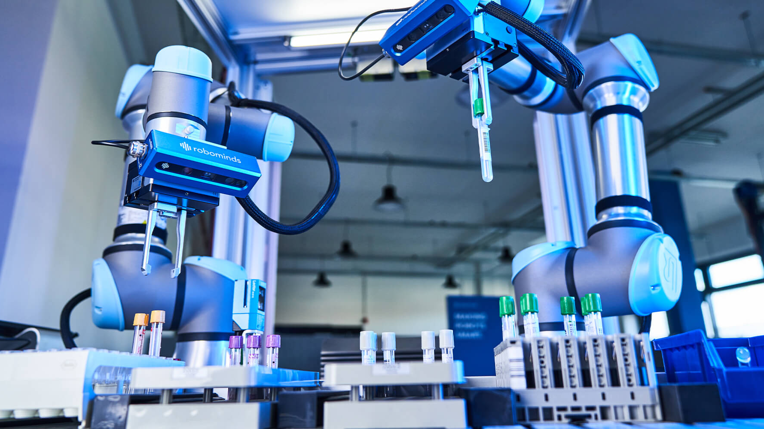
05
GO-TO-MARKET STRATEGY
Paid pilots, target segments, success metrics, and market entry timeline

Slide 24
Paid Pilots Only: The Four Commercial Protections
WHY PAID PILOTS, NOT FREE
In regulated and accreditation-sensitive lab environments, pilots don't only prove hardware - they force the real commercial work to happen: SOP alignment, IT integration, quality signoff, training cadence, floor ownership, and escalation paths. Opentrons and Automata both frame installation, IQ/OQ, protocol development, and ongoing support as core parts of deployment.
THE "DEAD ZONE" OF FREE PILOTS
FOUR COMMERCIAL PROTECTIONS
Lab agrees to free pilot. Since they paid nothing:
✕ They delay meetings
✕ Ignore feedback, don't assign staff
✕ After 6 months: "We'll get back to you"
1
Billable workflow scope - clearly defined what the pilot covers
2
Customer obligations - bench space, utilities, LIS access, process owner
3
Conversion clause - 50-100% of pilot fees credited against production deployment
4
Data-rights clause - de-identified operational events for improving scheduling, vision, exception handling
Without these protections, the startup may create buyer education and product learning without monetizing either. That risk is particularly high if the company drifts toward unpaid "innovation pilots."
24

Slide 25
Target Lab Segments: Three-Tier Pilot Strategy
TIER 1
TIER 2
TIER 3
Regional Private Reference Lab
Chain Hub or Spoke-Hub Central Lab
Hospital Enterprise / PPP / Public
▶ 1,500-3,000 samples/day
▶ Existing LIS, multi-bench
▶ Independent or promoter-led
Why attractive:
Fastest commercial learning. Decision-making tighter than large chains. Pain is visible on the floor.
Sales cycle: 6-12 weeks
Pilot fee: Rs.3-5 lakh
Conversion: Hybrid default
▶ 3,000-5,000 samples/day
▶ National quality function
▶ Multiple analyzer vendors
Why attractive:
Best lighthouse value. Highest expansion upside if one site succeeds. Strongest source of fleet data.
Sales cycle: 3-6 months pilot, 6-9 months rollout
Pilot fee: Rs.5-8 lakh
Conversion: Selective RaaS or Hybrid
▶ 800-2,000 samples/day
▶ High urgency, service complexity
▶ District integrated lab
Why attractive:
Good for credibility and tenderability. Public-health use cases. But slowest path.
Sales cycle: 6-12+ months
Pilot style: Managed-service
Conversion: Hybrid later when procurement path clear
RECOMMENDED ORDER OF ATTACK
1. Regional private reference lab (fastest learning) → 2. Chain hub lab (lighthouse + expansion) → 3. Hospital enterprise or PPP/public lab (credibility, tenderability)
25

Slide 26
Pilot Success Metrics: Operational, Financial, and Quality-Linked
The most important metrics are NOT "robot cycles completed." They are business outcomes.
Metric Category | What to Measure | Target Benchmark
Operational | Reduction in manual touches per sample | >50% reduction
Operational | Automation coverage on scoped workflow | >=70% automated routing
Quality | Barcode-read success rate | 98.5%+
Reliability | System uptime during staffed hours | >=98%
Speed | p95 TAT improvement on target benches | 15-25% reduction
Quality | Mis-sort or exception rate | Near-zero
Financial | FTE hours redeployed (not removed) | Measurable redeployment
WHY THESE METRICS MATTER
PROCUREMENT TEAMS
QUALITY TEAMS
LAB MANAGERS
CLINICIANS
Care about cost reduction, payback period, ROI numbers
Care about error rates, traceability, audit compliance
Care about TAT, throughput, bench utilization, staff redeployment
Care about faster reports, fewer errors, reliable turnaround
26

Slide 27
Market Entry Timeline: July 2026 - July 2027
JUL-AUG 2026
SEP-OCT 2026
NOV-DEC 2026
JAN-MAR 2027
APR-MAY 2027
JUN-JUL 2027
PAID PILOTS
HYBRID LAUNCH
LIGHTHOUSE RaaS
MULTI-SITE
PLATFORM
OEM / IP
Paid regional pilots with regional private reference labs
Rs.3-5 lakh per pilot
Standard hybrid offer launched
Rs.22-35L narrow
Rs.30-45L broad
+ Rs.0.8-1.5L/mo software
Chain hub pilot under selective RaaS
Rs.2.5-4.5L/mo
+ setup fee
36-48 month term
Multi-site rollouts based on pilot success
Reference rights from lighthouse chains
Workflow libraries and dashboards
Installation and validation playbooks
OEM and licensing exploration
Partner-driven revenue streams
PRICE BOOK (12-18 MONTHS)
STANDARD PRODUCTION OFFER
LIGHTHOUSE MANAGED SERVICE
Rs.22-35 lakh narrow deployment
Rs.30-45 lakh broader version
+ Rs.0.8-1.5 lakh/month software, monitoring, support
+ Annual PM or wear-part revenue
Reserved for most referenceable accounts
Rs.2.5-4.5 lakh/month
+ Setup fee
36- to 48-month term
Important: Do not default to low-fee per-test pricing unless the contract includes a floor that covers gross profit and financing cost.
27

Slide 28
06
MODELS WE REJECTED & WHY
Transparent analysis of why alternative business models don't fit our phase-one product

Slide 29
Why We Rejected Pure CapEx, Pure RaaS, Per-Test, and Revenue-Share
PURE CapEx-ONLY
PURE RaaS AS DEFAULT
Works for big labs but startup needs data to train model and analyze pain points. Once set up, only reason they need us is maintenance. Team doesn't want to build high-maintenance robots - maintenance adds throughput time, which goes against our mission.
Startup takes ALL the risk. Robot breaks, customer cancels, robot sits unused - you lose money. Example: Rs.20 lakh cost, Rs.1 lakh/month revenue = 20+ months to recover. If customer leaves after 6 months, you lose. That's why we stay general - we can repurpose the robot.
PER-TEST PRICING
REVENUE-SHARE
We don't control the expensive part (reagents, assays). Labs make money from tests, we only automate movement. Example: Lab earns Rs.500 for blood test, our robot saves Rs.5 worth of labor. If we charge Rs.1 per test, we may be undercharging massively. Value is up to lab's view - very hard to demand fair price.
Hard to prove causality. Was the revenue increase from better marketing? More customers? New tests? Or your robot? Labs will say "The extra revenue wasn't because of your robot." Endless arguments. For pre/post-analytical automation, this model is usually messy.
THE COMMON THREAD
All four rejected models share one fundamental problem: they either don't give us the data we need to improve our VLA model, or they don't compensate us fairly for the value we create, or they put too much risk on our balance sheet. The hybrid model is the only approach that balances upfront cash recovery with recurring revenue, data collection, and risk management.
The VLA advantage: Because our robot is general-purpose, even if a partner leaves we can repurpose the robot for a different process just by fine-tuning. That's the magic of a VLA-based approach - the robot is never stranded.
29

Slide 30
07
RISKS, LIMITATIONS & CONCLUSION
Honest assessment of uncertainties and the path forward

Slide 31
Open Questions & Honest Limitations
1
BOM & COST STACK UNCERTAINTY
2
REGULATORY CLASSIFICATION PATH
The BOM and deployed-cost stack is a modeled assumption anchored to public comparables, not supplier quotations for the exact motion system, safety architecture, vision stack, or local assembly approach. Real vendor quotes could move those numbers materially.
The best regulatory classification path depends on product claims. If positioned as pre/post-analytical automation and traceability infrastructure, the path is different than if making diagnostic claims or becoming tightly embedded in an IVD decision chain.
3
PER-TEST PRICING VALIDATION
4
PUBLIC PROCUREMENT COMPLEXITY
The per-test pricing discussion is anchored partly to public retail test prices at Metropolis, which are useful as a visible market ceiling but are not the same as every lab's realized B2B economics. Transactional pricing should be validated against actual customer mix before productizing it.
Public procurement for hospital and government customers is structurally slower and less uniform than private procurement. GeM-linked procurement norms exist, and some state hospital systems have tightened controls over direct purchasing, but actual route-to-market still varies by institution and state.
A NOTE ON METHODOLOGY
This report is rigorous on commercial structure, but these items remain inherently uncertain and should be treated that way. The report treats regulation mainly as a procurement-and-validation burden rather than giving formal legal classification advice.
On balance, the evidence supports a clear answer: sell the phase-one product as focused operational infrastructure with recurring software and service, not as a one-off robot and not as a thin per-test utility. That is the model most consistent with the market, the product wedge, and the current maturity of the concept.
31

Slide 32
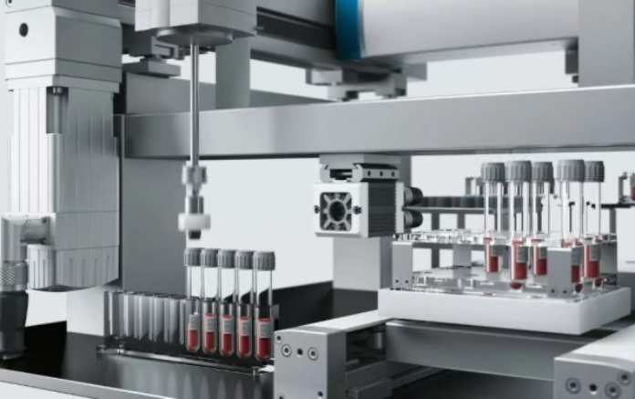
The Final Recommendation: Sell Infrastructure, Not Novelty
WHAT CUSTOMERS ACTUALLY CARE ABOUT
✓ Fewer mistakes - wrong sample handling costs money
✓ Faster reporting - happier doctors and patients
✓ Less labor - less repetitive work for skilled staff
✓ Better compliance - easier accreditation
✓ Better tracking - know where every sample is
✓ Better utilization - keep analyzers busy
WHAT CUSTOMERS DO NOT CARE ABOUT
They don't care about VLA, transformers, neural networks, or motion planning. The founder says "Look at my amazing AI-powered gantry robot!" The customer says "Will this reduce errors by 30%?" The robot is simply a tool to achieve operational goals.
"Our robots keep all the other robots in your lab busy."
The evidence supports a clear answer: sell the phase-one product as focused operational infrastructure with recurring software and service.
32

Slide 33
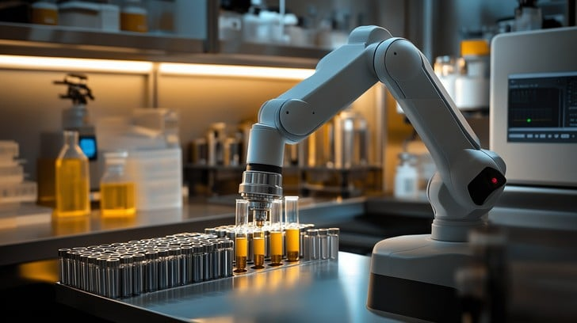
BUILDING THE FUTURE OF LAB AUTOMATION IN INDIA
HYBRID MODEL | PAID PILOTS | QUALITY NARRATIVE
Data-driven evolution. Every phase funds the next.
Every deployment makes the model smarter.
Rs.15-30L Deployment + Rs.50K-2L/mo Software + Annual Service Tiers
Phase 0 Simulations | Phase 1 Gantry | Phase 2 +Arm | Phase 3 +2 Arms
June 2026

